Slide 1
For instructors
Code Afrique Team

Slide 2
Philosophy
Means: students should try it out. Mentors should help out.
Relate to what they already know
They know functions: start with functions
Don’t introduce things until they need it
Don’t teach more than students need for the programming problems
Except print/input, because it’s fun

Slide 3
Outline
Defining functions (and using Spyder)
Errors / bugs
Strings
Lists
Variables
Loop (“stylized” for loops only)
Ranges
If statements
Functions calling functions
How to solve a programming problem
Input/Output
Day 1, morning
Day 1, afternoon
Day 2, morning

Slide 4
Eliminated
Booleans, and, or, not, …
String escaping, single quoted strings, string slicing
Compound assignment operators like +=, -=
Object orientation, methods (everything is functional now)
Mutable data structures, arrays
Data type discussion
“Laundry lists” (i.e., operators)
External libraries
Elif
While loops
Infinite loop interruption
Comments (except commenting out functions)

Slide 5
Intro
To
Python
Code Afrique Team

Slide 6
What is Python?
A language to tell a computer what to do
Computers are stupid---they need to be told EXACTLY what to do
There are many programming languages
Python is good for learning to program

Slide 7

Basic concept: Functions
For example:
$f\left(x\right)= 3x + 4$
$g\left(x\right)=$ $\sqrt{x}$
$sum\left(x, y\right)= x + y$

Slide 8
Functions in Python
def f(x):
return 3 * x + 4
def square(x):
return x * x
Function “header”
“Body”
Another function header
Another body
Notes:
In Python, function is a group of related statements that perform a specific task.Let them play around on the laptops with creating their own functions. Do not forget to mention DOC strings

Slide 9
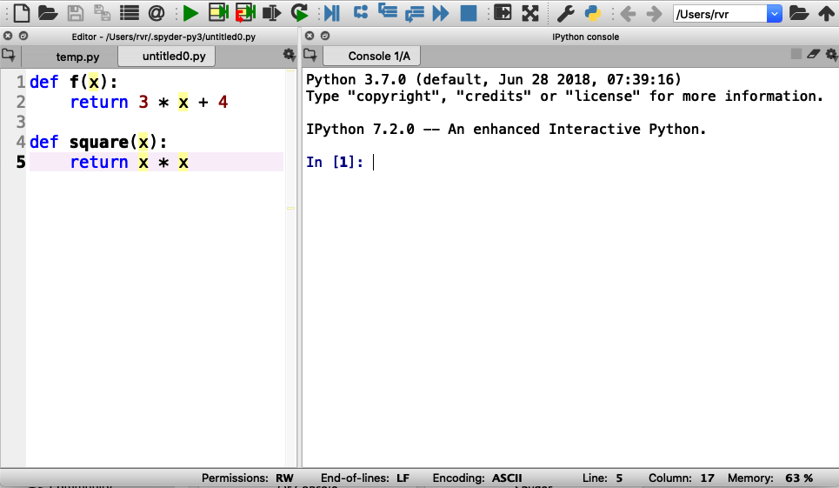
Using Spyder
Step 1: Enter functions in this box
Notes:
Everybody should do this. Wait for everybody to be done. Note that we only put function definitions in the left box and nothing else

Slide 10
Using Spyder
Step 2: Click on the green triangle (don’t forget)

Slide 11
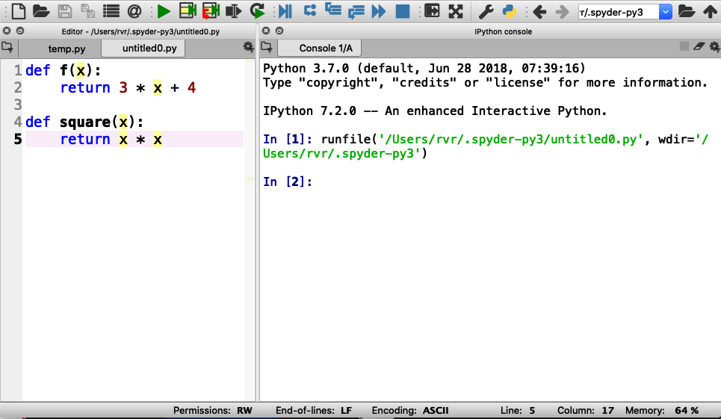
Using Spyder
Step 2: Click on the green triangle (don’t forget)
Output (and error messages) appear in “console” box

Slide 12

Using Spyder
Step 3: Type a function call here and hit “enter”

Slide 13
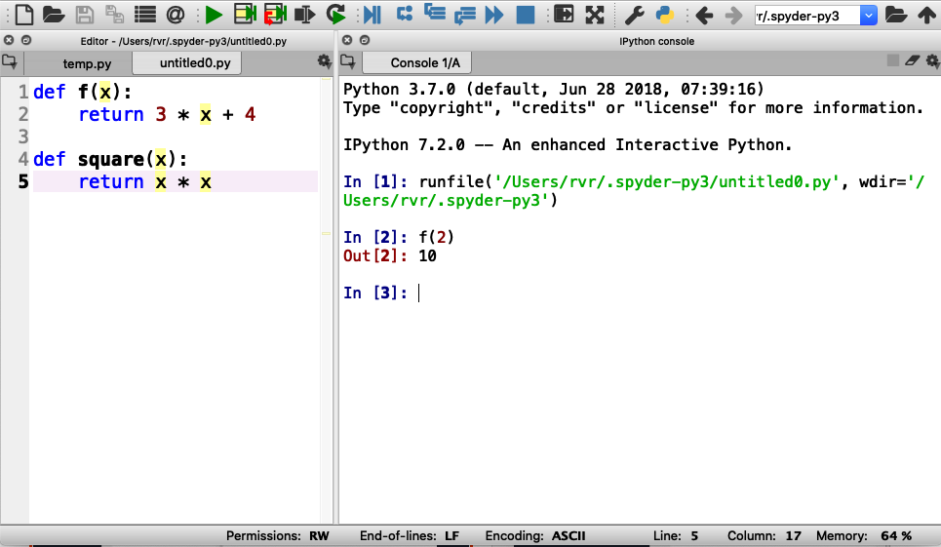
Using Spyder
Step 3: Type a function call here and hit “enter”
Result of function printed here
Notes:
After this, have them try other invocations of f() and square()

Slide 14

Try the following (and take turns!):
$f(0)$
$f(0.5)$
$f(−3)$
$square(−3)$
$square(123456789)$
$square(f(0))$

Slide 15
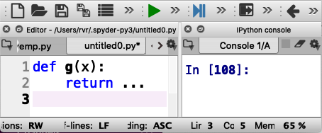

Now define functions yourself
Write the following function in Python :
$g\left(x\right)=x^{2}$ $+ 2x + 3$
Evaluate :
$g(0)$
$g(1)$
$g(−0.5)$
dot dot dot
Write your code here
Notes:
Add

Slide 16
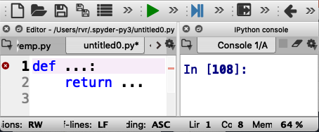

More time for you to play
Write a function $add\left(x, y,z\right)$ that returns the sum of its three inputs (that is, $x + y + z$)
Evaluate the following:
$add(1, 2, 3)$
$add(1, 1, −2)$
Notes:
Add

Slide 17
Errors and Bugs….
Remember: computers are stupid
Everything needs to be EXACTLY right

Slide 18
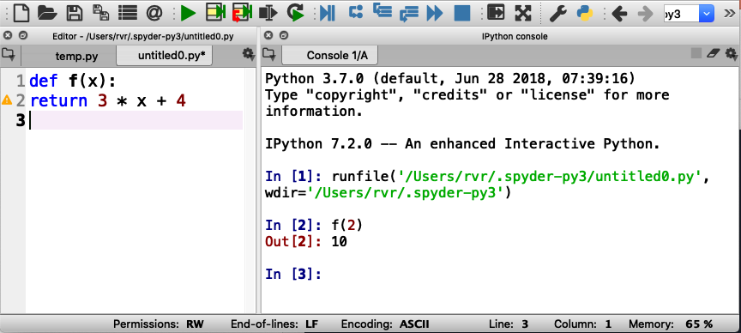
Indentation error
Everything in a function
MUST BE indented

Slide 19
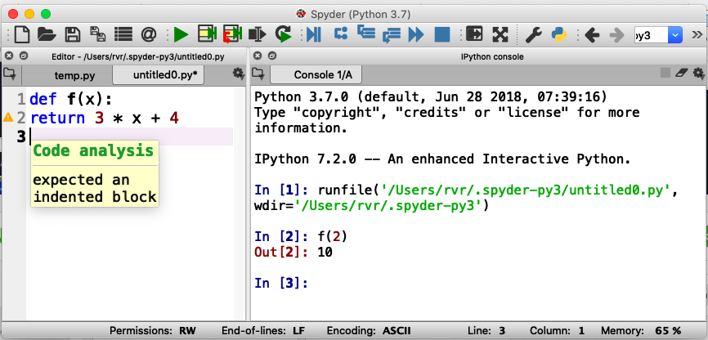
Indentation error
Hover mouse over triangle for information about the error

Slide 20
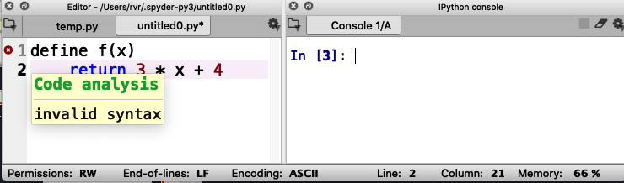
Syntax error
Missing :

Slide 21
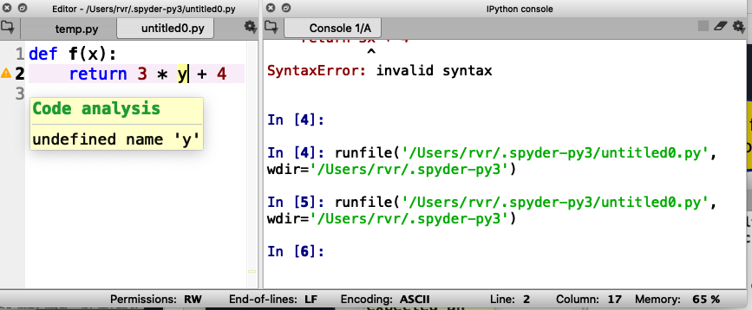
Undefined name warning
Should be ‘x’, not ‘y’

Slide 22
Remember: Keep hitting that green triangle
You need to do that each time you change or fix your code!

Slide 23
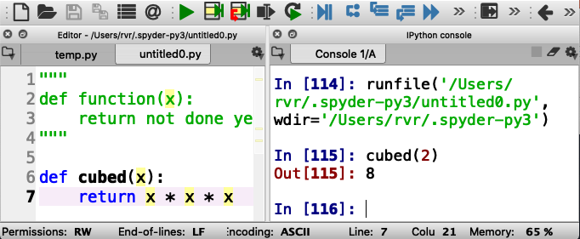
Tip: “commenting out functions”
If you want to save a function you are working on but it does not quite work yet, you can temporarily “comment it out”.
To do this, place three parentheses before and after the function at the beginning of the line

Slide 24
What have we learned so far?
You can define functions in Python
In Spyder, you enter functions in the “left box”
You can try out functions in the ”right box”
You need to deal with errors to get things to work
You can comment out functions temporarily

Slide 25
“Strings”

Slide 26
Strings are fun!
Examples of strings: “hello” “I love Code Afrique” “fdalepru”
A string is enclosed in quotation marks (“)
You can glue together two strings using +
For example, “hello, “ + “Jon” evaluates to
“hello, Jon”

Slide 27
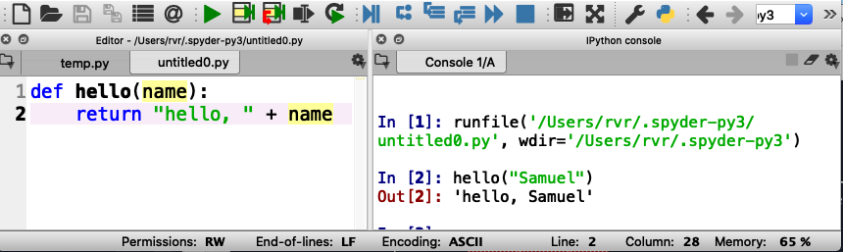
Functions with strings
Write a function hello(name) that returns the string “hello, name”

Slide 28
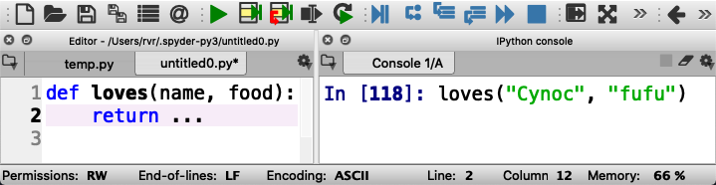
Now you try it (remember, take turns)
Write a function loves(name, food) that returns a string “name loves food”
Be sure to test it here
(and take turns!)
dot dot dot
Write your code here

Slide 29
String indexing
A position in a string is called an index
Indexes start counting at 0
Shoshana
01234567
The index of ‘o’ is 2

Slide 30
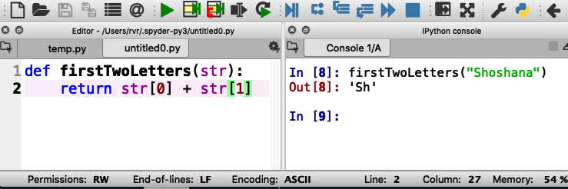
String indexing
Write a function firstTwoLetters(str)that returns the first two letters in the input string str
str[x] evaluates to the letter at index x
Notes:
Square brackets

Slide 31
String indexing
Write a function firstTwoLetters(str)that returns the first two letters in the input string str
str[x] evaluates to the letter at index x
Do not confuse:
f(x) - call function f with
input parameter x
s[x] - get the letter at index x
from string s
Notes:
Square brackets

Slide 32
Quiz
If a string has 10 letters, what is the index of the last letter?
9
10
11
Notes:
The correct answer is A: 9

Slide 33
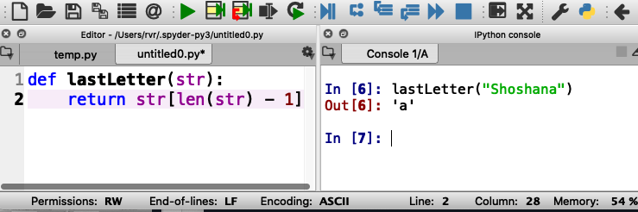
Length of a string
Write a function lastLetter(str)that returns the last letter in the input string str
Use len(str) that returns the length of str

Slide 34
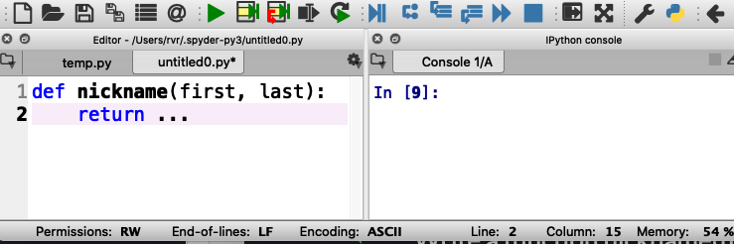
What is your Code Afrique nickname?
Write a function nickname(first, last)that consists of the first three letters of your name (first name) followed by the last three letters of your surname (last name) , followed by “ca” (for Code Afrique)
For example: nickname(“Hakim”, “Weatherspoon”) is “Hakoonca”

Slide 35
What have we learned about strings?
A string is a list of letters, enclosed by parentheses
We can glue two strings together with +
We can get the length of string s with the function len(s)
Letters in a string are indexed from 0
To get the letter of string s at index x, use s[x] (square brackets!)

Slide 36
Lists

Slide 37
Examples of lists
[ 1, 2, 3 ] a list of numbers
[ “cats”, “dogs”, “mice” ] a list of strings
[ ] an empty list

Slide 38
Examples of lists
Lists use “square brackets” [ ]
[ 1, 2, 3 ] a list of numbers
[ “cats”, “dogs”, “mice” ] a list of strings
[ ] an empty list

Slide 39
Examples of lists
Lists use “square brackets” [ ]
[ 1, 2, 3 ] a list of numbers
[ “cats”, “dogs”, “mice” ] a list of strings
[ ] an empty list
Fun fact: a string is a list of letters, and everything you can do with strings you can also do with other lists

Slide 40
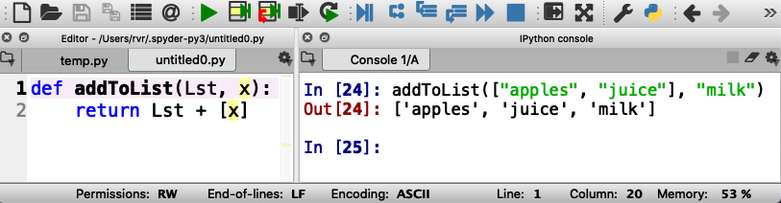
Example function with lists
Write a function addToList(Lst, x) that returns a new list consisting of Lst and x
For example addToList([ “apples”, “juice” ], “milk”) becomes [ “apples”, “juice”, “milk” ]
List consisting of x
Notes:
Have students type this in and try out other examples

Slide 41
Try it out (and take turns!)
Notes:
Have students type this in and try out other examples

Slide 42
What have we learned about lists?
You can put anything in a list
They are much like strings, therefore..
We can glue two lists together with +
We can get the length of list Lst with the function len(Lst)
Elements of a list are indexed from 0
To get the element of string Lst at index x, use Lst[x]

Slide 43
Variables

Slide 44
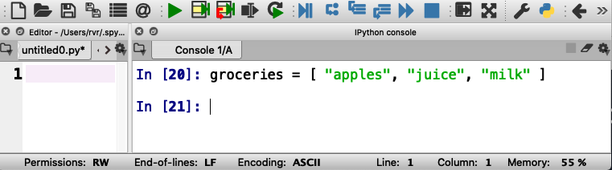
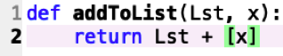
How to keep a shopping list?
groceries is a “variable”
Variables remember values so you can use them later

Slide 45
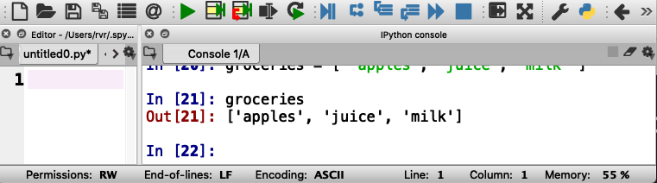
How to keep a shopping list?
Python can recall the value of groceries

Slide 46
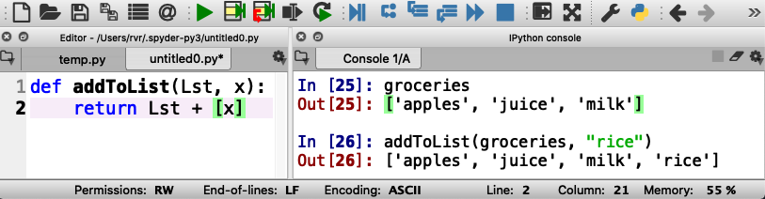
Example: adding “rice” to the shopping list
Does it work?

Slide 47
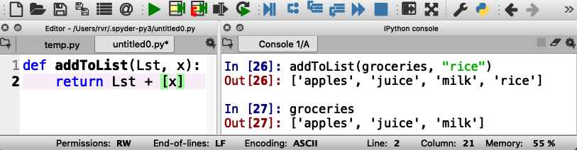
Example: adding “rice” to the shopping list
The value of groceries has not changed…
(because we didn’t tell Python to do that)

Slide 48
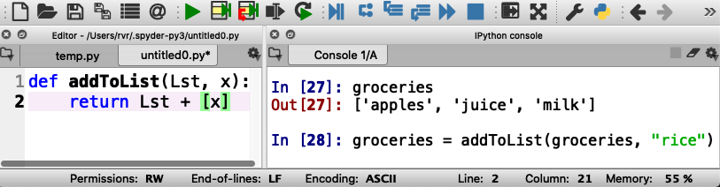
Example: adding “rice” to the shopping list
Here we tell Python to store a new value for groceries

Slide 49
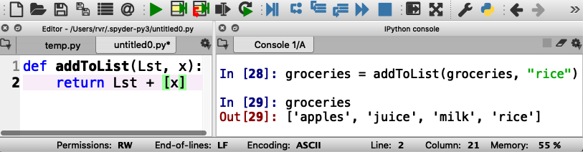
Example: adding “rice” to the shopping list
Now “rice” is in groceries

Slide 50
Example: adding “rice” to the shopping list
Now practice adding some more items to groceries

Slide 51
What have we learned about variables?
Each variable has a name
You can store any value in a variable
The notation for this in Python is x = value
You can change the value of a variable the same way

Slide 52

Loops

Slide 53
Doing something with each element of a list
Write a function product(Lst) that returns the product of all elements in a list of numbers
How would you do this writing on a piece of paper?

Slide 54
Doing something with each element of a list
Write a function product(Lst) that returns the product of all elements in a list of numbers
How would you do this writing on a piece of paper?
Start with the first number
Multiply with the next number
Repeat until done with all numbers
This is called a “loop”

Slide 55
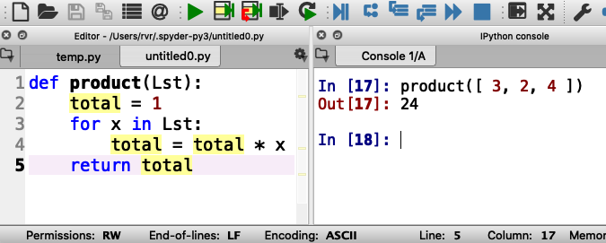
Loops in Python

Slide 56
Loops in Python
total is a variable

Slide 57
Loops in Python
total is a variable
x is an element in Lst
Notes:
“next element” is confusing. Seems like you mean “after 1”. Maybe it just needs to be explained by the instructor.

Slide 58
Loops in Python
total is a variable
x is an element in Lst
total is updated each time

Slide 59
Loops in Python
total is a variable
x is an element in Lst
total is updated each time
Here, total is 1 * 3 * 2 * 4

Slide 60
Write your own: below change product to sum That is, add all the items in the list together

Slide 61
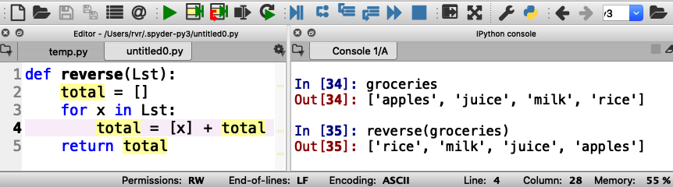
Example: write a function reverse(Lst) that reverses the elements in a list

Slide 62
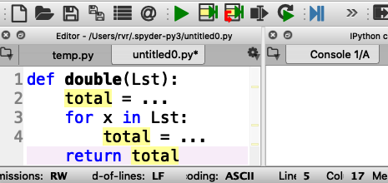
More practice with loops (remember: everybody gets a turn!)
Write a function double(Lst) that returns a list consisting of all the numbers in Lst, but then doubled
For example, double([ 3, 1, 4 ]) should return [ 6, 2, 8 ]

Slide 63
Working with ranges
Write a function squares(start, end) that returns a list of all the squares of the numbers start (inclusive) through end (exclusive)
(in Computer Science, “inclusive” means that the value is included, and “exclusive” means that the value is excluded)
For example, squares(1, 10) should return
[ 1, 4, 9, 16, 25, 36, 49, 64, 81 ]

Slide 64
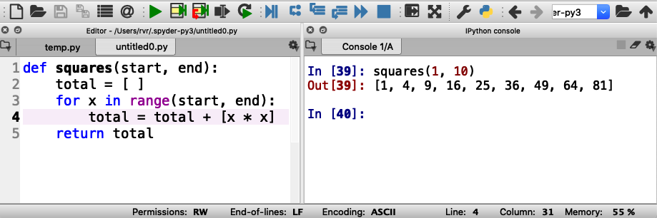
Working with ranges
range(start, end) generates the integers from start (inclusive) to end (exclusive)

Slide 65
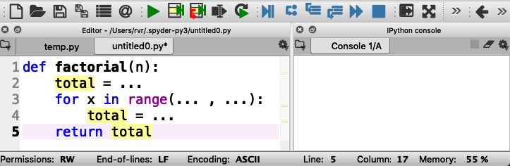
Your turn to practice with ranges
Write function factorial(n) that returns n!
n! is defined to be the product of all the integers from 1 to n
For example, factorial(3) is equal to 1 * 2 * 3 (that is, 6)

Slide 66
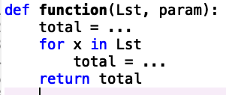
What have we learned about loops?
You can use a loop to visit every element in a list (or string)
Alternatively, you can use a loop to visit over a range
range(start, end) includes start but not end
Generic format of a function with a loop:

Slide 67

IF STATEMENTS

Slide 68
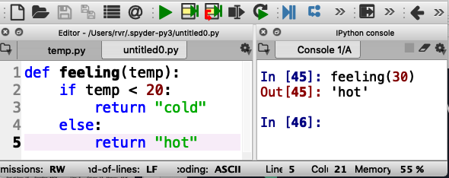
What if you want to do something only sometimes?
Write function feeling(temp) that returns “cold” if temp < 20 or “hot” otherwise

Slide 69
Correct indentation is important!

Slide 70
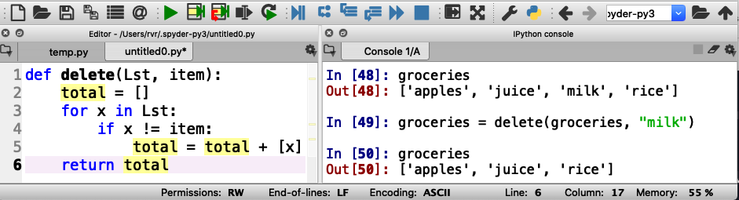
Using if statements in for loops
Write a function delete(Lst, item) that returns a list consisting of the elements of Lst except for item
!= means “is not the same as”

Slide 71
Correct indentation

Slide 72
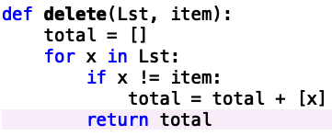
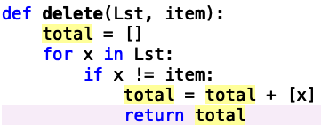
Incorrect indentations: what do these do?

Slide 73
Incorrect indentations: what do these do?
This returns after the first element in Lst
This returns after the first element that is not item
Notes:
Also, doesn’t return anything if the list is empty

Slide 74
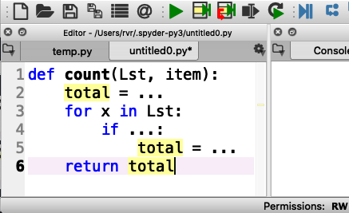
Your turn to practice
Write a function count(Lst, item) that counts how many times item occurs in Lst
For example, count([“apples”, “juice”, “apples”], “apples”) should return 2

Slide 75
What have we learned about if statements?
You can use an if statement to execute code based on a condition
An if statement may have an “else” part (but not required)
You have to get indentation just so
You can use != to test if two values are different or not
By the way, != works on numbers, strings, and even lists!

Slide 76
Programs with multiple functions

Slide 77
How to write difficult programs
Split program into multiple functions!
Write a function shop(Lst, item) that returns the string “we have item” if item is in Lst, or
“we need item” if not
For example: shop(groceries, “rice”) returns
“we have rice” if ”rice” is in groceries
Notes:
Multiple functions?

Slide 78
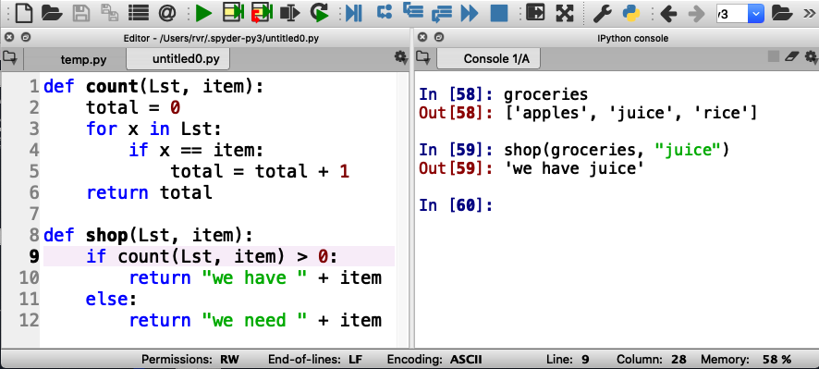
How to write difficult programs
Split program into multiple functions!
Write a function shop(Lst, item) that returns the string “we have item” if item is in Lst, or “we need item” if not

Slide 79
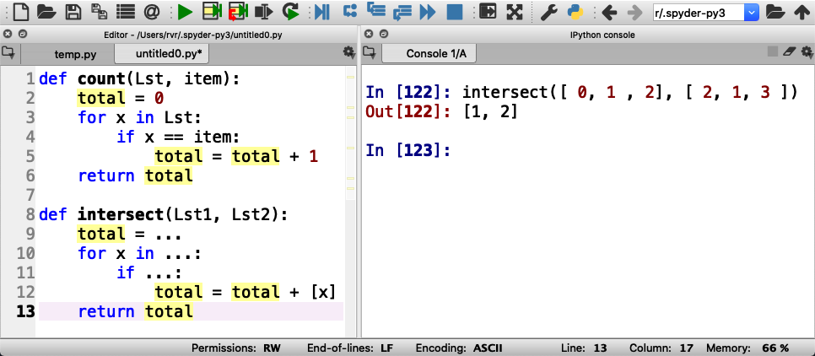
Practice writing a difficult program
Write a function intersect(Lst1, Lst2) that returns the intersection of lists Lst1 and Lst2 (a list of the elements that are in both lists).
You can again use the count(list, item) function to simplify the task

Slide 80
Just a little math before we go on

Slide 81
Two types of numbers
“integers”
Examples: 0, 1, 2, 3, -3, 93723881
”floating point numbers”
Examples: 3.14159, -0.05, 123.45

Slide 82
Division with integers and floating point numbers
What is 9 divided by 4?
Using integers, it is 2 with a remainder of 1
Using floating point numbers, it is 2.25

Slide 83
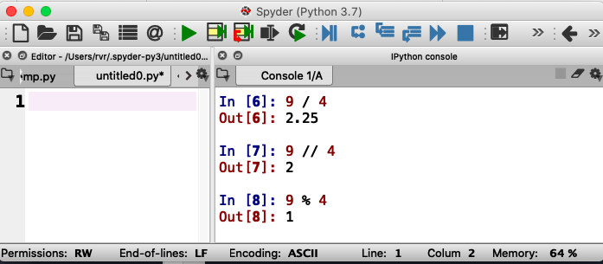
Same thing in Python
Floating point division
Integer division
Integer remainder (modulo)
You say “9 modulo 4”

Slide 84
Approaching Coding Questions

Slide 85
A 3-Step Approach To Coding Problems
Read the question carefully. Understand what information you have available to you and what the question wants you to do.
Try to write out an algorithm or solution to the problem in “English” or “pseudocode”.
Translate your English solution to code

Slide 86
Example
Q: Write a function oddOrEven(x) that returns “even” if x is even and “odd” if not

Slide 87
Step 1: Read the question carefully
Q: Write a function oddOrEven(x) that returns “even” if x is even and “odd” if not
After reading the question, we see that we have one integer number as our only input.
Since our function only has one input, our function header will look something like:
def oddOrEven(x):

Slide 88
Step 2: Design a solution in “English”
Q: Write a function oddOrEven(x) that returns “even” if x is even and “odd” if not
If the input parameter is divisible by 2, then we know it is even
Otherwise, it must be odd
We also know that we can check if something is divisible with the modulo operator, %

Slide 89
Step 3: translate English into code
If the input parameter is divisible by 2, then it is even
if num % 2 == 0:
return “even”
Otherwise, it must be odd
else:
return “odd”
== is used to check if two values are the same
(do not confuse with =, which is used to assign a value to a variable!)

Slide 90
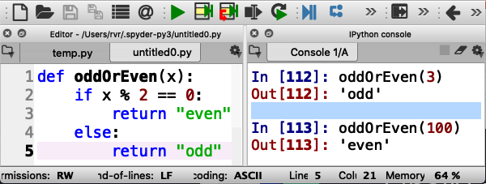
Finally, test it out
Test carefully!

Slide 91
Time to practice
Write a function isPrime(n) that returns “yes” if n is prime and “no” otherwise
In English: a number n is prime if it can only be divided by 1 and itself
(1 is an exception: it is not considered prime)
So, try to divide n by all numbers between 2 and n-1 and make sure there is always a non-zero remainder

Slide 92
A primer on conversion

Slide 93
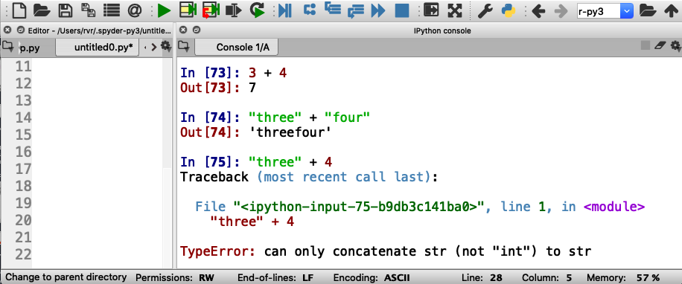
Strings and Numbers
3 + 4 == 7
“three” + “four” == “threefour”
What is ”three” + 4???

Slide 94
Strings and Numbers
3 + 4 == 7
“three” + “four” == “threefour”
What is ”three” + 4?

Slide 95
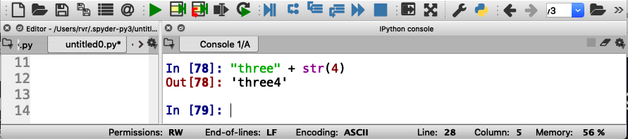
Converting integers to strings
str(4) is the string “4”

Slide 96
Input/Output

Slide 97
Python functions can “print” (output) and read from the keyboard or even files (input)
Write a function needToShop(Lst) that asks for the name of an item and prints the item and how many instances of the item are in Lst
Note: the item is not an input parameter to needToShop(Lst)

Slide 98
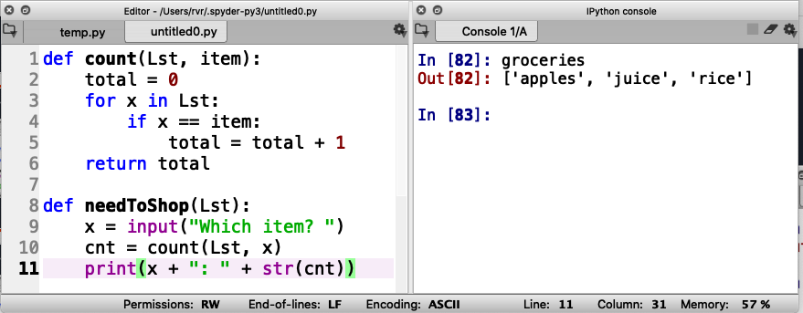
Function needToShop(Lst)

Slide 99
Function needToShop(Lst)
Read input

Slide 100
Function needToShop(Lst)
Read input
Write output

Slide 101
Function needToShop(Lst)
Read input
Write output
Note integer to string conversion

Slide 102
Function needToShop(Lst)
Read input
Write output
no return statement

Slide 103
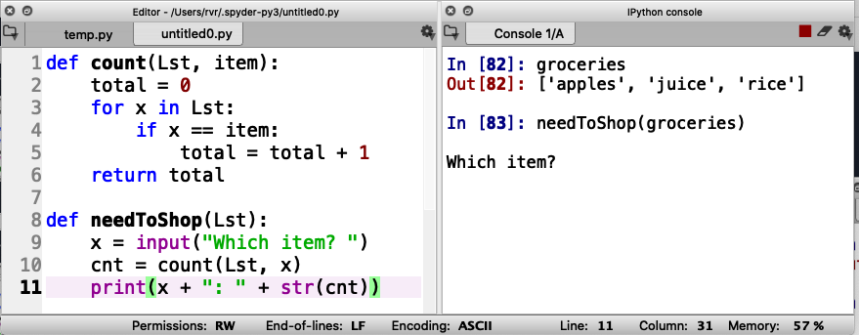
Function needToShop(Lst)
Call function here
Read input
Write output

Slide 104
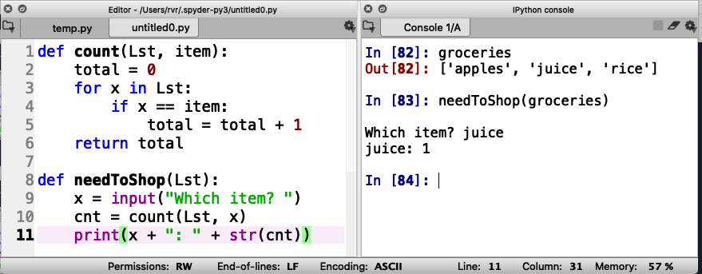
Function needToShop(Lst)
Call function here
Read input
Enter input here
Write output

Slide 105
Give it a shot yourself (and take turns!)

Slide 106
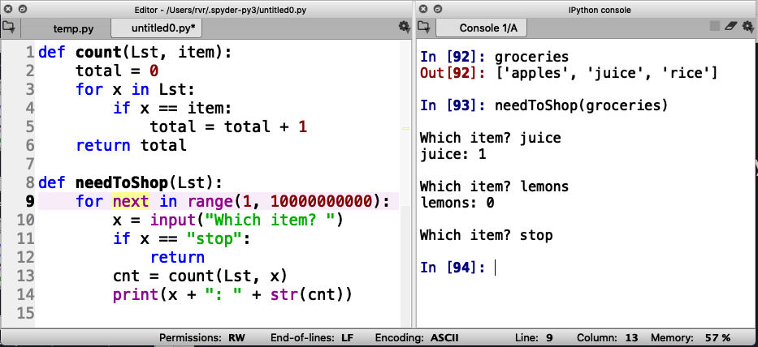
Input/Output in a loop
How to ask for input over and over again?

Slide 107
Input/Output in a loop
How to ask for input over and over again?
Long loop

Slide 108
Input/Output in a loop
How to ask for input over and over again?
Long loop
Add a way to stop

Slide 109
Input/Output in a loop
How to ask for input over and over again?
Long loop
Add a way to stop
Return with no value

Slide 110
Try it out

Slide 111
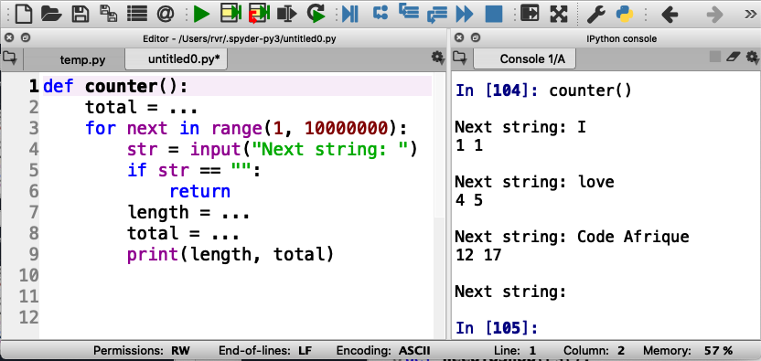
Write your own function
Write a function that, in a loop, reads a string and prints the length of the string and the total length of all the strings that were input. Stop if the input is the empty string (“”).
Recall that len(str) returns the length of string str

Slide 112
What have we learned about input/output
You can print values using the print(value) statement
You can input values using the input(prompt) statement (where prompt is a string that is printed to ask the user for input)

